Slide 1

Pike’s Peak Initial Race Results
Chris McLean

Slide 2
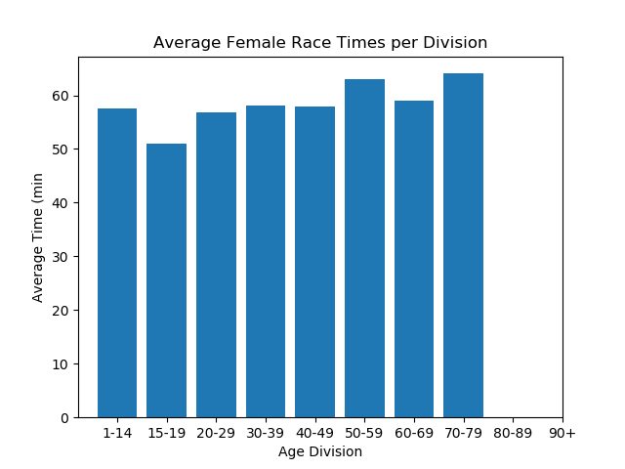
Female Race Results
Q1 the mean race time for females is 0:58:00
Q1 the median race time for females is 0:57:26
Q1 the mode race time for females in seconds is
0 2886.0 (48:06)
1 3095.0 (51:35)
2 3179.0 (52:59)
3 3209.0 (53:29)

Slide 3
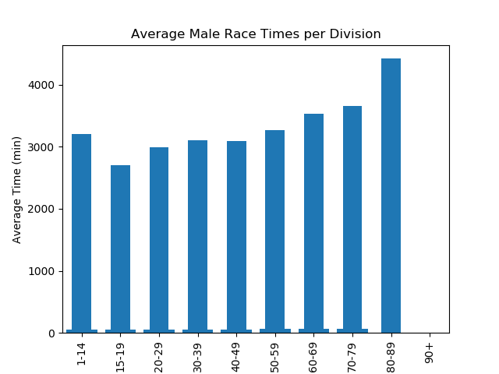
Male Race Results
Q1 the mean race time for males is 0:52:07
Q1 the median race time for males is 0:51:22
Q1 the mode race time for males in seconds is
0 2128.0 (35:28)
1 2825.0 (47:05)
2 2843.0 (47:23)
3 2988.0 (49:48)
4 2998.0 (49:58)
5 3080.0 (51:20)
6 3126.0 (52:06)
7 3162.0 (52:42)
8 3264.0 (54:24)
9 3403.0 (56:42)

Slide 4
Gun and Net Times, Chris Doe and Top 10%
Q2 the difference between gun and net time results for females is on average 0:03:11
Q2 the difference between gun and net time results for males is on average 0:02:30
Q3 the difference between Chris Doe's time and the top 10% of his division is 0:06:06

